Slide 1
Loan Default Data analysis: Insights and Recommendations
By - Dhruba Jyoti Chakraborty

Slide 2
Agenda:
Introduction & Project Overview
Imbalanced Data & Risk Segmentation
Loan Characteristics & Default Risk
Credit Score & Default Risk
Other Key Insights (Loan Purpose, Demographics, Region)
Business Recommendations

Slide 3
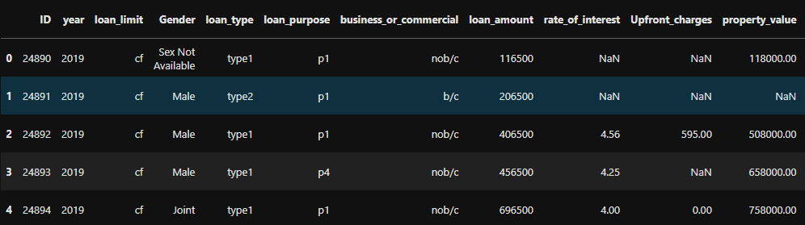
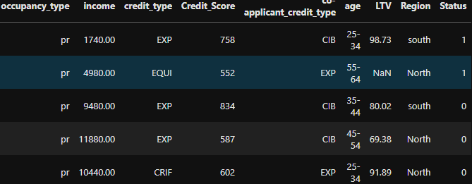
Project overview Title: Project Introduction
Objective:
In this loan default project, we aim to analyze patterns and risk factors driving loan defaults, using
data-driven insights to help the business reduce default rates and optimize loan offerings. The project
focuses on identifying key variables like loan amount, LTV, credit score, and interest rates that influence
default behavior.
Data Summary:
Number of records: 148,670 loans
Key Variables: Loan Amount, Interest Rate, LTV (Loan-to-Value), Credit Score, Income, Loan Purpose, etc.
Methods Used: Exploratory Data Analysis (EDA), Data Imputation, Risk Segmentation

Slide 4
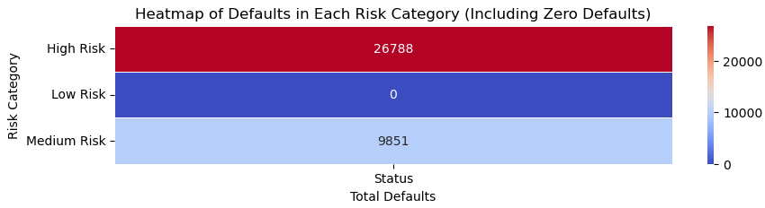
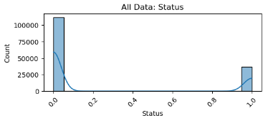
Key Observation 1 - Imbalanced Data & Risk Segmentation Title: Imbalanced Dataset & Risk Segmentation
Imbalance: The dataset is skewed, with more non-defaulters (112,031) than defaulters (36,639).
Segmentation:
High-Risk Segment: 26,788 defaulters
Medium-Risk Segment: 9,851 defaulters
Low-Risk Segment: 0 defaults (only 7 customers)
Insight: The majority of defaults are concentrated in the high-risk segment, which requires targeted strategies.

Slide 5
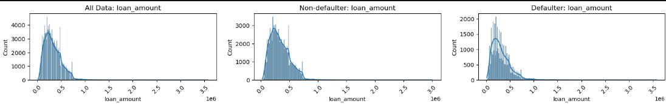
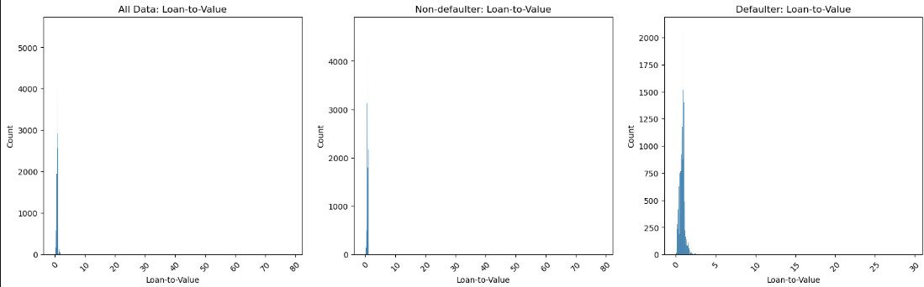
Key Observation 2 - Loan Characteristics and Default Title: Loan Amount, LTV
Loan Amount: Most loans fall between 196,500 and 436,500.
Insight: Larger loans don't directly correlate with defaults but require more scrutiny.
LTV (Loan-to-Value): Mean LTV for defaulters is 0.77 (riskier), while non-defaulters have a lower LTV (0.72).
Recommendation: Loan terms should be stricter for customers with higher LTV ratios (above 0.75).

Slide 6
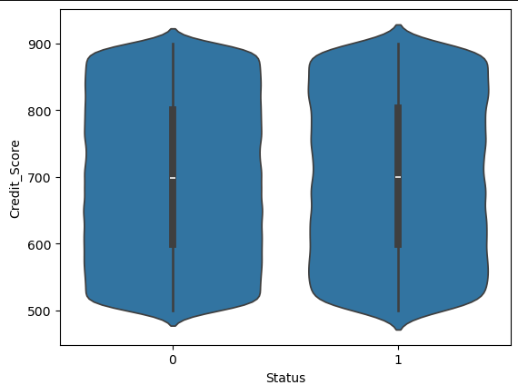
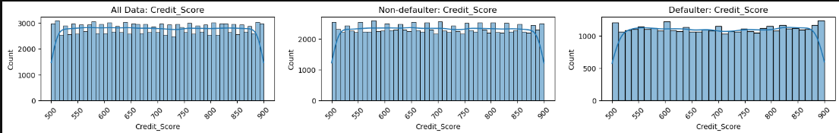
Key Observation 3 - Credit Score & Default Risk Title: Credit Score Patterns
Distribution: Credit scores range between 500 and 900, with a mean of 700.
Insight: Borrowers having same credit score distribution both who defaulted and non defaulters. No pattern found.
Recommendation: Implement risk-based pricing and loan restructuring for borrowers other metrics.

Slide 7
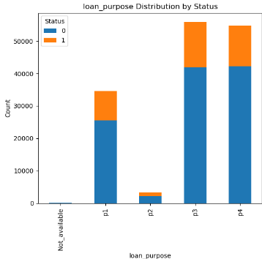
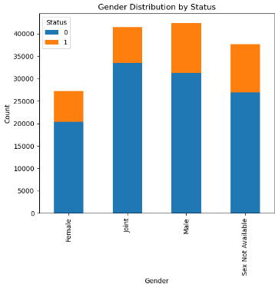
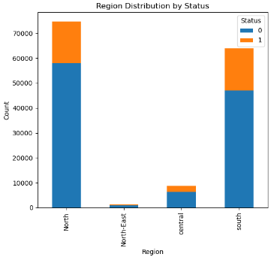
Other Observations Title: Additional Insights
Loan Purpose: Purposes like P1, P3 and P4 are prevalent among both defaulters and non-defaulters.
Demographics: Female borrowers show lower default rates than male or joint applicants.
Region: There is a significant differences in default rates across regions. North and South are predominant.
Recommendation: Design specialized loan products for low-risk purposes and female borrowers.

Slide 8
Business Recommendations Title: Key Recommendations for Stakeholders
Develop Risk-Based Pricing Models Implement tiered pricing based on credit scores and LTV ratios and other useful features. For instance, offer competitive rates for borrowers with credit scores above 700 while charging higher rates for those below 600.
Enhance Customer Segmentation and Targeting Use data to tailor marketing strategies for different customer groups. For example, offer personalized loan terms to low-risk female borrowers and higher-value loans to customers aged 25-54.
Introduce Specialized Loan Products Create loan products for popular purposes like P3,P4. For example, offer a secured home loan product with lower interest rates to encourage responsible borrowing.

Slide 9
Business Recommendations Title: Key Recommendations for Stakeholders
Leverage LTV and LTI Ratios in Underwriting Set stricter criteria for borrowers with high LTV ratios. For example, require larger down payments for loans where the LTV exceeds 0.75 to minimize risk.
Refine Data Collection and Handling of Missing Values Improve processes to minimize missing values in crucial data fields. For instance, implement regular audits of data entries and use automated tools to fill gaps before loan decisions are made.
Target Larger Loans with Caution Implement stricter checks for larger loan amounts. For example, require higher credit scores for loans exceeding $500,000 to reduce potential defaults while maintaining competitive offerings.

Slide 10
Thank you

